Slide 1
Planning in 2020: An Update
5 February 2021
Alex Sutherland
ampersandadvocates.com
1

Slide 2
The Agenda
Sec 42 Applications: City of Edinburgh Council v Scottish Ministers
Tilting the Balance (and Back Again): Gladman Developments Ltd v Scottish Ministers
The Common Good: Guild v Angus Council
How to Assess the Setting of a Listed Building: Liddell v Argyll and Bute Council
When an Application for Planning Permission Is ‘Made’: Ramoyle Developments Ltd v Scottish Borders Council
Planning Conditions and Vetoes: Community Windpower Ltd v Scottish Ministers
Use Classes: Macintyre v Scottish Ministers

Slide 4
City of Edinburgh Council v Scottish Ministers 2020 SC 336
The Outline Permission
1(a): Application for the approval of the under-noted reserved matters [be] made within fifteen years of the date of the Outline Permission, (except where an application for approval of any reserved matters has been refused or an appeal against such refusal has been dismissed, in which case one further such application may be made within six months of the date of such refusal or dismissal, even though fifteen years from the date of the Outline Permission have expired).
1(b): The approved development [shall be] commenced no later than fifteen years from the date of the Outline Permission or two years from the date of the final approval of any reserved matters, whichever is the greater.

Slide 5
City of Edinburgh Council v Scottish Ministers 2020 SC 336
A Practical Approach
It is not disputed that a successful application under sec 42 of the 1997 Act to allow a person to proceed with a development, which is permitted under an earlier permission, without complying with a condition of that permission, amounts to the grant of a new permission. It follows that any decision on whether to grant the application must be in accordance with the current development plan 'unless material considerations indicate otherwise' (1997 Act, sec 25(1)). [37]
In a case where the development has not yet commenced and the effect of a refusal would mean that the original permission cannot be implemented, this may involve a reconsideration of the principle of development in light of any material change in the development plan policies […]. That is so even if sec 42(2) stipulates that it is only the question of the condition, from which compliance is sought to be avoided, that is to be considered. [38]

Slide 6
City of Edinburgh Council v Scottish Ministers 2020 SC 336
A Practical Approach
That is not to say that, in practical terms, every sec 42 application requires to involve a complete reconsideration of the planning merits of a development de novo. The situation on the ground must be taken into account. Where, as here, the original outline planning permission has been implemented to a substantial extent, that will be a material consideration of some force. […] As a material consideration, depending on the facts and circumstances, it may well indicate that a new planning policy should not be enforced with the vigour which might be appropriate in an entirely new application or in a sec 42 application in respect of a development which has not commenced. [39]

Slide 7
City of Edinburgh Council v Scottish Ministers 2020 SC 336
A Practical Approach
[T]here was no need for the reporter to set out any test or the criteria which he was applying in circumstances in which the question was a relatively straightforward one of whether, in effect, to allow the outline permission to continue, and thus to permit further reserved matter applications, or whether to require the developers to lodge a new application for outline permission in respect of those parts of the site which remain undeveloped. [40]
[T]he reporter records, correctly, that there are outstanding reserved matter applications. This is a relevant matter. The reporter is describing the context in which the sec 42 application has been made […] It was a living permission involving a continuing process of reserved matter approvals over time. The nature of this progress was important when determining whether the original timescale should be extended. [48]
Also, never forget to move for expenses at the time. See para [26].

Slide 9
Gladman Developments Ltd v Scottish Ministers 2020 SLT 898
Scottish Planning Policy (2014)
Paragraph 125
Where a shortfall in the 5-year effective housing land supply emerges, development plan policies for the supply of housing land will not be considered up-to-date, and paragraphs 32-35 will be relevant.
Paragraph 33
Where relevant policies in a development plan are out-of-date or the plan does not contain policies relevant to the proposal, then the presumption in favour of development that contributes to sustainable development will be a significant material consideration. Decision-makers should also take into account any adverse impacts which would significantly and demonstrably outweigh the benefits when assessed against the wider policies in this SPP.

Slide 10
Gladman Developments Ltd v Scottish Ministers 2020 SLT 898
In [Graham’s The Family Dairy] the court determined […] the effect of SPP paras 33 and 125 where a shortage of housing land had been identified. This was that the shortage became a significant material consideration in favour of the grant of permission for housing development. The court appreciated that the precise wording of para 33 was that it was the presumption in favour of development that became a significant material consideration. What the court was engaged in was an explanation of the practical import of the paragraph in terms of decision making. In determining to refuse planning permission, the counterbalancing factors require to outweigh that consideration “significantly and demonstrably”. This is part of the equation for determining whether a development is, in overall terms, sustainable. It is not an exercise which is undertaken after a determination on sustainability has taken place. [44]

Slide 11
Gladman Developments Ltd v Scottish Ministers 2020 SLT 898
What should have happened?
A housing development which will remedy, to some extent, a housing shortage is something which almost inevitably “contributes to sustainable development”, which is what para 33 requires, in one degree or another. It will do so also in terms of the economic benefits of construction and in other ways too. Whether it is, in overall terms, a sustainable development is another question. That is one for planning judgment, but it involves the use of the tilted balance. The correct approach, in practical terms, where there is a housing shortage, is to regard that shortage as “a significant material consideration”. It is not determinative. [46]

Slide 12
Gladman Developments Ltd v Scottish Ministers 2020 SLT 898
What should have happened?
Parties were agreed that the reporter had not applied the tilted balance. The question was whether she ought to have done so. The Court said yes.
The starting point ought, on the contrary, to have been that there was a presumption in favour of this development because, inter alia, it provided a solution, at least in part, to the housing shortage. Thereafter, the question was whether the adverse impacts, notably the other policies in the development plan, “significantly and demonstrably outweighed” the benefits of the development in terms of the housing shortage and the economic gain. [47]

Slide 13
Gladman Developments Ltd v Scottish Ministers 2020 SLT 898
Scottish Planning Policy: Finalised Amendments (December 2020)
The SPP presumption aimed to support sustainable development, not development at any price or in any location. Appeal decisions to date have generally focused first on ensuring proposals are sustainable in line with this intention. (p 8)
However the interpretation of the policy as established by the Gladman case and so the use of a strongly ‘tilted balance’, has the potential to mean that developments that may otherwise (i.e. without the use of a tilted balance) be judged to be unsustainable may be granted consent where there is a shortfall in the housing land supply. (p 8)

Slide 14
Gladman Developments Ltd v Scottish Ministers 2020 SLT 898
Scottish Planning Policy (2020)
Paragraph 125
Where a proposal for housing development is for sustainable development and the decision-maker establishes that there is a shortfall in the housing land supply in accordance with Planning Advice Note 1/2020, the shortfall is a material consideration in favour of the proposal.
Paragraph 33
Where a proposal is for sustainable development, the presumption in favour of sustainable development is a material consideration in favour of the proposal.

Slide 16
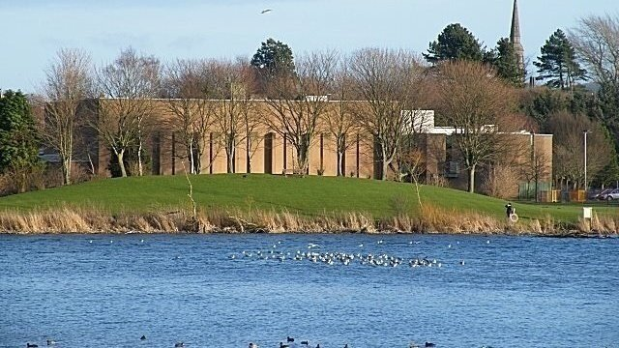

Slide 17
Guild v Angus Council 2020 SLT 939
Community Empowerment (Scotland) Act 2015
Section 104 (Disposal and use of common good property: consultation)
Subsection (2) applies where a local authority is considering:
(a) disposing of any property which is held by the authority as part of the common good, or
(b) changing the use to which any such property is put.
(2) Before taking any decision to dispose of, or change the use of, such property the local authority must publish details about the proposed disposal or, as the case may be, the use to which the authority proposes to put the property.

Slide 18
Guild v Angus Council 2020 SLT 939
(1) Are the buildings of the leisure centre being held by the respondents as part of the common good? Yes.
Magistrates of Banff v Ruthin Castle 1944 SC 36 was binding and consistent with principle [35]-[36]:
In the present case there is no dispute that the land on which the leisure centre was built forms part of the common good of the local authority. It follows that the leisure centre also forms part of the common good. [36]

Slide 19
Guild v Angus Council 2020 SLT 939
(2) If so, is demolition of those buildings encompassed within the term “disposal of any property”? Yes.
The demolition of the leisure centre will have the result that the inhabitants of the burgh will no longer have indoor sports facilities, toilet facilities and café facilities on this site […] I consider that when the respondents are considering demolition of the leisure centre they are indeed considering disposing of it. [41]
[A] wide construction must be given to the words “disposing of any property”, particularly in a statute which is concerned with improving transparency and encouraging community participation in such decisions. [44]

Slide 20
Guild v Angus Council 2020 SLT 939
(3) If the answer to (1) is yes, and the answer to (2) is no, does demolition of the buildings and returning the land to open parkland amount to changing the use to which the property is put? Yes.
If a local authority wished to demolish a sports and leisure centre containing a swimming pool, squash courts, keep fit area and other indoor sports facilities, and replace it with an opera house, concert hall or cinema, both the existing and the proposed uses might be described as use for leisure purposes, but I consider that the proposal would involve a change of use. [45]

Slide 21
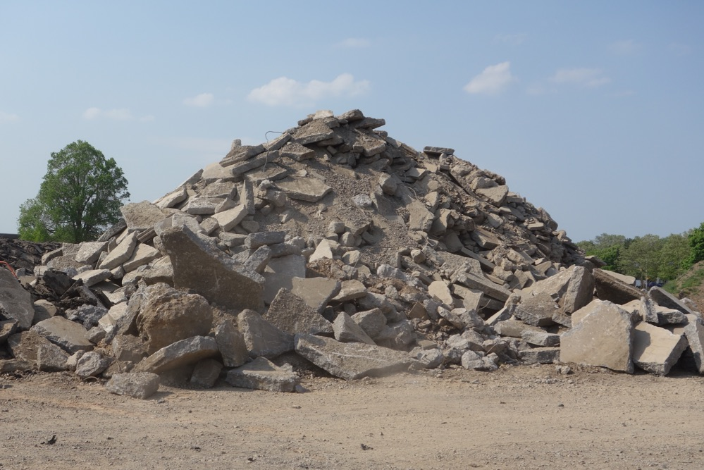

Slide 22
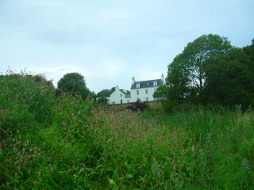

Slide 23
Liddell v Argyll and Bute Council 2020 SLT 956
Planning (Listed Buildings and Conservation Areas) (Scotland) Act 1997
Section 59 (General duty as respects listed buildings in exercise of planning functions)
(1) In considering whether to grant planning permission for development which affects a listed building or its setting, a planning authority or the Secretary of State […] shall have special regard to the desirability of preserving the building or its setting or any features of special architectural or historic interest which it possesses.

Slide 24
Liddell v Argyll and Bute Council 2020 SLT 956
The three principles in Catesby Estates Ltd v Steer [2018] EWCA Civ 1697 at paras [28]-[30]
[C]an it be said that the decision maker did not understand the setting of the listed building, and whether the proposed development would be within it or in some way related to it? In the court’s view, the answer is no. The contrary proposition depends upon the misconception that the planning officer could only reach a proper understanding after a visit to the house itself. There may be cases where a visit of that kind is obviously necessary, but there is no reason to place this officer’s task in that category. [21]

Slide 25
Ramoyle Developments Ltd v Scottish Borders Council
2020 SC 290
The Missives
As regards to the suspensive condition contained within clause 2.2.2, the purchasers shall lodge the application for planning consent with the local planning authority as soon as reasonably practicable following the date of purification or waiver of the suspensive condition contained within clause 2.2.4 and no later than the date falling six months after the said date of purification or waiver […] In the event that the purchasers have failed to submit the said application for planning permission with the local authority by the expiry of the said six month period then either party shall be entitled to rescind the missives (with no rights or liability due to or by either party) on serving written notice to that effect on the other before any subsequent waiver or purification of the said suspensive condition.

Slide 26
Ramoyle Developments Ltd v Scottish Borders Council
2020 SC 290
Town and Country Planning (Development Management Procedure) (Scotland) Regulations 2013
Regulation 14 (Validation date)
(1) An application made under any of regulations 9 to 12 is to be taken to have been made on the date on which the last of the items or information required to be contained in or accompany the application in accordance with regulations 9, 10, 11 or 12 respectively is received by the planning authority.

Slide 27
Ramoyle Developments Ltd v Scottish Borders Council
2020 SC 290
Condition 2.5.2 uses ordinary, non-technical words which anyone would readily understand. Until the requisite fee is paid, a planning authority is under no obligation to process an application, but this does not mean that a planning application cannot be lodged or submitted before the fee is paid. [14]
Clearly, whatever else, the fee needs to be paid before obligations are imposed upon the authority. So, if an application is submitted to a planning authority on a Monday, a necessary plan or other missing item of information on the Wednesday, and the fee paid on the Friday, the application is complete and ‘taken to have been made’ on the Friday, but it remains true that it was lodged (or submitted) on the Monday. [16]

Slide 28
Community Windpower Ltd v Scottish Ministers [2020] CSIH 17
Planning Conditions
Community Windpower Ltd were granted permission to construct a windfarm in East Ayrshire. The permission was subject to conditions, one of which was that ‘fully operational replacement water supplies’ had to be in place for certain properties. Certain proprietors would not allow the developers to connect the water supply to their properties’ internal pipework.
East Ayrshire Council served an enforcement notice, on the basis that the conditions had not be complied with. The reported refused the developers’ appeal. The developers appealed to the Court of Session.

Slide 29
Community Windpower Ltd v Scottish Ministers [2020] CSIH 17
The developers argued that, where a water supply had been brough to the boundary, and all that had prevented connection to the internal pipework was proprietors’ refusal of consent, the reporter ought to have found that the requirement for a fully operational replacement water supply had been met. That would prevent the absurdity of conferring a veto on third parties.
The Court (Lords Brodie, Malcolm and Pentland) held that the natural and ordinary meaning of the words left little room for ambiguity. Connection with the internal pipework was required (para [46]). While the developers’ submission was ‘not without attraction’, it was contrary to the natural and ordinary meaning of the words (para [50]). The condition required a state of affairs, not an attempt to achieve a state of affairs (para [48]).

Slide 30
Macintyre v Scottish Ministers [2021] CSIH 5
CrossReach applied to Stirling Council for a certificate of lawfulness (in terms of section 151 of the 1997 Act) in relation to a development of Dumbrock House, Old Mugdock Road, Strathblane.
The property would be used to accommodate four children and young people, supported by carers working shifts. The lawfulness of the development depended on whether that use of the property fell within Use Class 9, i.e. use
as a house, other than a flat, whether or not as a sole or main residence, by […] (ii) not more than 5 residents living together including a household where care is provided for residents.

Slide 31
Macintyre v Scottish Ministers [2021] CSIH 5
Neighbours expressed concern about the proposal. The planning authority refused CrossReach’s application. The reporter granted it. The neighbours appealed to the Court of Session.
The Court (LP, Lords Menzies and Pentland) dismissed the appeal, holding (i) that the carers did not constitute ‘residents’, taking the number of residents above five (paras [39]-[40]) and (ii) that there was no requirement that the five residents living together ‘as a single household’. The guidance to the contrary in Circular 1/1998 was incorrect (paras [36]-[38]). The use of Dumbrock House fell within Use Class 9.

